Slide 1
GEFCO
Packaging catalogue
January 2009 - TLI/LOG/GSM

Slide 2
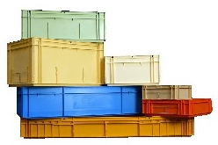
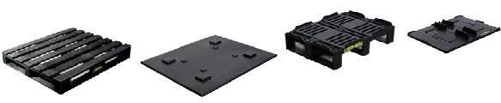
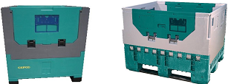
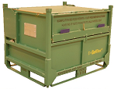
A full range of material handling solutions
Boxes
  Rigid
  Foldable
Pallets and covers
  Wooden
  Plastic
Foldable Containers
Specific packaging
  Adapted to customer needs
Dedicated packaging
  Specific flows

Slide 3





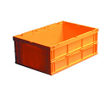


GALIA boxes
BEIGE BOX 5L
Ref. : 3212
Dimensions : 300 x 200 x 114 mm
Usable Volume : 4 L
Weight : 570 g
Loading :
  800x600 : 24 boxes/UM, 256UM/truck
  1000x1200 : 60 boxes/UM, 130UM/truck
MANDARIN BOX
Ref. : 1315
Dimensions : 1200 x 330 x 150 mm
Usable Volume : 40 L
Weight : 3700 g
Loading :
  1000x1200 : 12 boxes/UM, 78UM/truck
ORANGE BOX 10L
Ref. : 4312
Dimensions : 400 x 300 x 114 mm
Usable Volume : 9 L
Weight : 930 g
Loading :
  800x600 : 24 boxes/UM, 128UM/truck
  1000x1200 : 60 boxes/UM, 78UM/truck
IVOIRY BOX 20L
Ref. : 4322
Dimensions : 400 x 300 x 214 mm
Usable Volume : 18 L
Weight : 1440 g
Loading :
  1000x1200 : 30 boxes/UM, 78UM/truck
GREEN FOLDABLE BOX 39L
Ref. : 6423
Dimensions : 600 x 400 x 214 mm
Usable Volume : 39 L
Weight : 2380 g
Folded Loading :
  1000x1200 : 40 boxes/UM, 78UM/truck
GREEN BOX 40L
Ref. : 6422
Dimensions : 600 x 400 x 214 mm
Usable Volume : 39 L
Weight : 2380 g
Loading :
  1000x1200 : 15 boxes/UM, 78UM/truck
YELLOW FOLDABLE BOX 59L
Ref. : 6433G
Dimensions : 600 x 400 x 314 mm
Usable Volume : 59 L
Weight : 2960 g
Folded Loading :
  1000x1200 : 40 boxes/UM, 78UM/truck
YELLOW BOX 60L
Ref. : 6432
Dimensions : 600 x 400 x 314 mm
Usable Volume : 59 L
Weight : 2960 g
Loading :
  1000x1200 : 10 boxes/UM, 78UM/truck

Slide 4

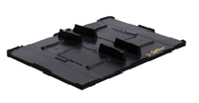
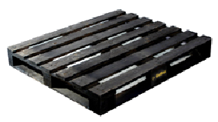
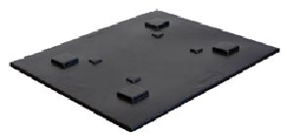
Pallets and Covers
Small black plastic pallet
Ref. : P6080
Dimensions : 800 x 600 x 180 mm
Weight : 7,6 kg
Geometry : 3 bottom boards
Small black plastic cover
Ref. : C6080
Dimensions : 800 x 600 x 78 mm
Weight : 2,1 kg
Black wooden pallet
Ref. : P1210
Dimensions : 1200 x 1000 x 150 mm
Weight : 30 kg
Geometry : 5 perimeter bottom boards
Black plastic cover
Ref. : 1210
Dimensions : 1200 x 1000 x 25 mm
Weight : 6,2 kg

Slide 5

Elementary Pallets : PE

Slide 6
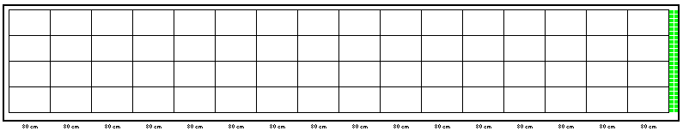
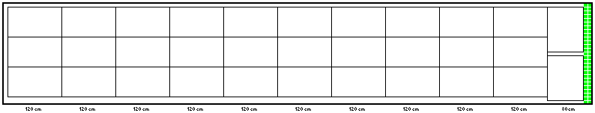
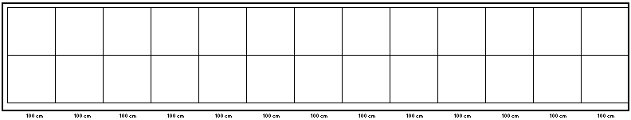
Truck Loading Plan (Dimensions : 2,40 m x 13 m; height 2,40 m)
Loading Plan for 800x600 Pallets
16 rows of 4
TOTAL : 64 UM on the ground
Loading Plan for 800x1200 Pallets
10 rows of 3
1 row of 2
TOTAL : 32 UM on the ground
Loading Plan for 1000x1200 Pallets
13 rows of 2
TOTAL : 26 UM on the ground

Slide 7

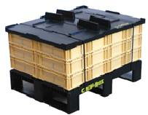
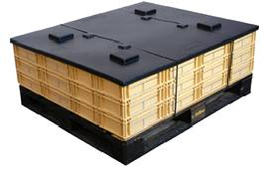



BEIGE BOX 5L GALIA reference : 3212
PLA05
Dimensions in mm:
External : 300 x 200 x 114
Internal : 263 x 163 x 94
Collar : 15
Usable Volume : 4 L
Weight: 570 g
Carrying Capacity : 15 kg
Static load : 225 kg
525 mm
1 cover ref. : C6080
1 pallet ref. : P6080
24 boxes ref. : 3212
PE05L
Palletisation plan
Number of layers : 3
475 mm
1 cover ref. : 1210
1 pallet ref. : P1210
60 boxes ref. : 3212
PLA05
PLA05 | 256 UM | 3/1 | 4/1
PE05L | 130 UM | 4/1 | 9/1
PE05L

Slide 8

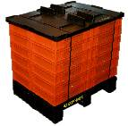
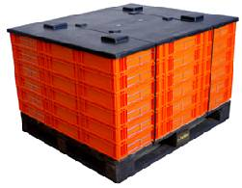
ORANGE BOX 10L GALIA reference : 4312
PLA10
Dimensions in mm:
External : 400 x 300 x 114
Internal : 362 x 263 x 94
Collar : 15
Usable Volume : 9 L
Weight: 930 g
Carrying Capacity : 15 kg
Static load : 450 kg
1 cover ref. : C6080
1 pallet ref. : P6080
24 boxes ref. : 4312
620 mm
PE10L
Palletisation plan
Number of layers : 6
725 mm
1 cover ref. : 1210
1 pallet ref. : P1210
60 boxes ref. : 4312
PLA10
PLA10 | 128 UM | 1/1 | 4/1
PE10L | 78 UM | 2/1 | 5/1
PE10L

Slide 9

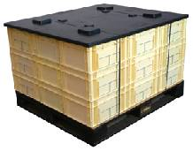
IVOIRY BOX 20L GALIA reference : 4322
Dimensions in mm:
External : 400 x 300 x 214
Internal : 362 x 263 x 194
Collar : 15
Usable Volume: 18 L
Weight: 1440 g
Carrying Capacity : 15 kg
Static load : 450 kg
PE20L
780 mm
1 cover ref. : 1210
1 pallet ref. : P1210
30 boxes ref. : 4322
Palletisation plan
Number of layers : 3
PE20L | 78 UM | 2/1 | 5/1
PE20L

Slide 10

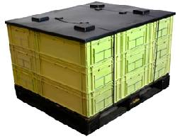
GREEN BOX 40L GALIA reference : 6422
Dimensions in mm:
External : 600 x 400 x 214
Internal : 560 x 362 x 194
Collar : 15
Usable Volume : 39 L
Weight: 2380 g
Carrying Capacity : 15 kg
Static load : 600 kg
PE40L
780 mm
1 cover ref. : 1210
1 pallet ref. : P1210
15 boxes ref. : 6422
Palletisation plan
Number of layers : 3
PE40L | 78 UM | 2/1 | 5/1
PE40L

Slide 11

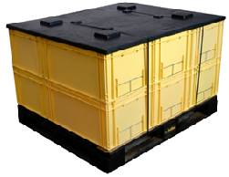
YELLOW BOX 60L GALIA reference : 6432
Dimensions in mm:
External : 600 x 400 x 314
Internal : 560 x 362 x 294
Collar : 15
Usable Volume : 59 L
Weight : 2960 g
Carrying Capacity : 15 kg
Static load : 600 kg
PE60L
780 mm
1 cover ref. : 1210
1 pallet ref. : P1210
10 boxes ref. : 6432
Palletisation plan
Number of layers : 2
PE60L | 78 UM | 2/1 | 5/1
PE60L

Slide 12

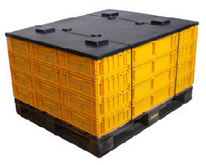
MANDARIN BOX GALIA reference : 1315
Dimensions in mm:
External : 1200 x 330 x 150
Internal : 1154 x 276 x 126
Collar : 15
Usable Volume : 40 L
Weight : 3700 g
Carrying Capacity : 15 kg
Static load : 400 kg
PLONG
730 mm
1 cover ref. : 1210
1 pallet ref. : P1210
12 boxes ref. : 1315
Palletisation plan
Number of layers : 4
PLONG | 78 UM | 2/1 | 5/1
PLONG

Slide 13
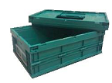
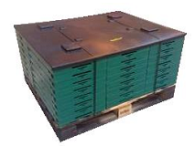
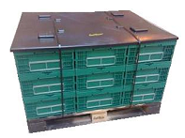
GREEN FOLDABLE BOX 39L GALIA reference : 6423
Dimensions in mm:
External : 600 x 400 x 214
Internal : 560 x 362 x 194
Collar : 15
External folded height : 60 mm
Usable Volume : 39 L
Weight : 2380 g
Carrying Capacity : 15 kg
Static load : 450 kg
PE39L Folded
665 mm
1 cover ref. : 1210
1 pallet ref. : P1210
40 boxes ref. : 6423
Unfolded
Palletisation plan
Number of layers : 8
PE39L Folded | 78 UM | 2/1 | 5/1
PE39L

Slide 14

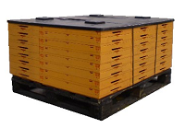
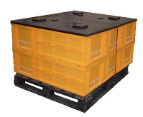
YELLOW FOLDABLE BOX 59L GALIA reference : 6433G
Dimensions in mm:
External : 600 x 400 x 314
Internal : 560 x 362 x 294
Collar : 15
External folded height : 60 mm
Usable Volume: 59 L
Weight : 2960 g
Carrying Capacity : 15 kg
Static load : 450 kg
PE59L Folded
665 mm
1 cover ref. : 1210
1 pallet ref. : P1210
40 boxes ref. : 6433G
Unfolded
Palletisation plan
Number of layers : 8
PE59L Folded | 78 UM | 2/1 | 5/1
PE59L

Slide 15
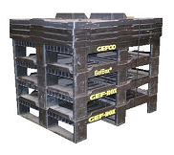
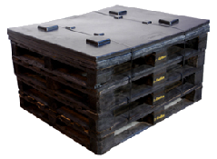
Pallet and cover sets
785 mm
PC8060
4 covers ref. : C6080
4 pallets ref. : P6080
PEPAL
660 mm
4 covers ref. : 1210
4 pallets ref. : P1210
PC8060 | 128 UM | 1/1 | 5/1
PEPAL | 78 UM | 2/1 | 5/1

Slide 16
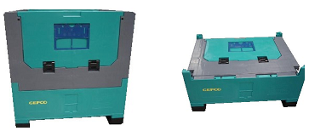
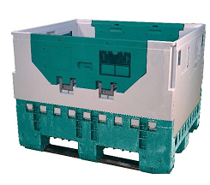
Foldable Containers : 868R and 91210R
Ref. 868R
Ref. 91210R
Dimensions in mm:
External : 800 x 600 x 835
Internal : 740 x 540 x 705
External folded height : 393 mm
Usable Volume : 281 L
Weight : 24 kg
Load Capacity : 700 kg
Static load : 2100 kg
Dimensions in mm:
External : 1200 x 1000 x 900
Internal : 1120 x 920 x 715
External folded height : 406 mm
Usable Volume : 736 L
Weight : 51 kg
Load Capacity : 500 kg
Static load : 2000 kg
868R | 128 unfolded – 384 folded | 1/1 unfolded – 6/1 folded | 3/1 unfolded – 6/1 folded
91210R | 52 unfolded – 156 folded | 2/1 unfolded – 6/1 folded | 4/1 unfolded – 14/1 folded

Slide 17
Specific packaging

Slide 18

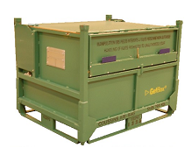
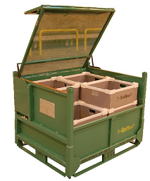
Green Airbag containers
Akylux ref. P005289
Weight : 154 g
Dimensions : 475 x 405 x 3,5 mm
Ref. 03293
Dimensions in mm:
External : 1200 x 1000 x 920
Internal : 1050 x 925 x 650
Usable Volume : 631 L
Weight: 190 kg
Load Capacity : 670 kg
Static load : 2010 kg
Akybox ref. 5290
Dimensions in mm:
External: 525 x 445 x 220
Internal : 520 x 440 x 215
Usable Volume : 49 L
Weight : 800 g
Carrying Capacity : 40 kg
Static load : 200 kg
AIRBAG CONTAINERS
1 container ref.: 03293
12 Akybox ref.: 5290
24 Akylux dividers ref.: P005289
AIRBAG CONTAINER | 78 UM | 2/1 | 3/1

Slide 19
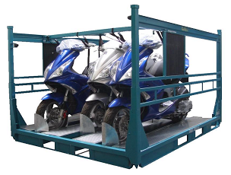
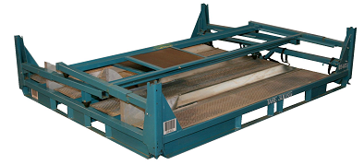
Motorbike rack
Ref. PMTC
Dimensions in mm:
External : 2300 x 1870 x 1420
External folded height : 500 mm
Weight : 300 kg
Load Capacity : 345 kg
Static load : 1935 kg
PMTC stand | 42 folded | 1/1 | 3/1

Slide 20
Dedicated packaging : Need Validation from GSM before starting for other clients

Slide 21

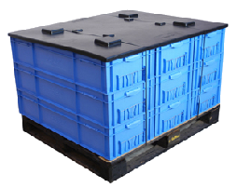
BLUE BOX reference : 1422
Will be stopped
Dimensions in mm:
External : 1000 x 400 x 214
Internal : 947 x 350 x 210
Collar : 12,5
Usable Volume : 67 L
Weight : 3400 g
Carrying Capacity : 15 kg
Static Load : 530 kg
PE70L
780 mm
1 cover ref. : 1210
1 pallet ref. : P1210
9 boxes ref. : 1422
Palletisation plan
Number of layers : 3
PE70L | 78 UM | 2/1 | 5/1
PE70L

Slide 22
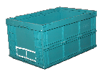
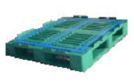
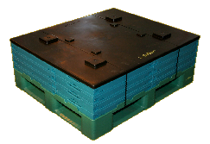
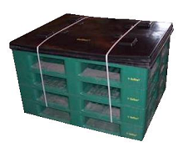
GREEN FOLDABLE BOX 59L reference : 6433
Dimensions in mm:
External : 600 x 400 x 314
Internal : 560 x 362 x 294
Collar : 15
External folded height : 60 mm
Usable Volume : 59 L
Weight : 2960 g
Carrying Capacity : 15 kg
Static Load : 450 kg
Blue/Green plastic pallet
Ref. : PK1210
Dimensions : 1200 x 1000 x 160 mm
Weight :
Geometry : 5 perimeter bottom boards
PKPAL
PK59L
4 covers ref. : 1210
4 pallets ref. : PK1210
345 mm
1 cover ref. : 1210
1 pallet ref. : PK1210
20 boxes ref. : 6433
660 mm
Palletisation plan
Number of layers : 4
PK59L | 130 UM | 4/1 | 9/1
PKPAL | 78 UM | 2/1 | 5/1
PK59L

Slide 23

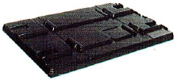
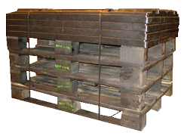
1200x800 pallet and cover sets
European Wooden black pallet
Ref. : PK1208
Dimensions : 1200 x 800 x 140 mm
Weight : 20 kg
Geometry : 3 bottom boards
European black cover
Ref. : C1208
Dimensions : 1200 x 800 x 87 mm
Weight : 5,8 kg
Photo en attente
P8K60L
1 cover ref. : C1208
1 pallet ref. : PK1208
8 boxes ref. : 6432
PC1208
4 covers ref. : C1208
4 pallets ref. : PK1208
Palletisation plan
Number of layers : 2
P8K60L | 96 UM | 2/1 | 5/1
PC1208 | 96 UM | 2/1 | 5/1
P8K60L

Slide 24

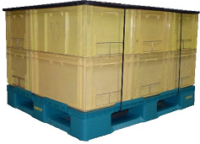
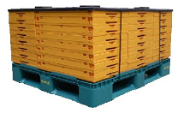
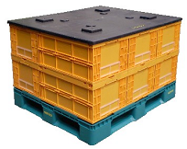
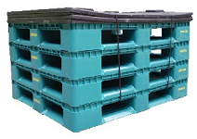
Plastic pallet reference PP1210
Blue/Green plastic pallet
Ref. : PP1210
Dimensions : 1200 x 1000 x 160 mm
Weight : 18 kg
Geometry : 5 perimeter bottom boards
780mm
PP60L
1 cover ref. : 1210
1 pallet ref. : PP1210
10 boxes ref. : 6432
Palletisation plan
Number of layers PP60L : 2
Number of layers PP59L : 8
Unfolded
PP59L Folded
665 mm
1 cover ref. : 1210
1 pallet ref. : PP1210
40 boxes ref. : 6433G
PC1210
PP60L or PP59L Folded | 78 UM | 2/1 | 5/1
PC1210 | 78 UM | 2/1 | 5/1
660 mm
4 covers ref. : 1210
4 pallets ref. : PP1210

